Slide 1
Predicting and Preventing Cancellations at StayWell Hotels
Data Analysis

Slide 2
Basic analysis
44224 of 119390 Bookings were Canceled
Categories to analyse
hotel
deposit_type
market_segment
distribution_channel
lead_time_bucket
customer_type
previous_cancellations
booking_changes
has_company / has_agent
arrival_date_month

Slide 3
Procedure
Phase 1: Clean & Prepare
Load data and Inspect for –ve values
Handle NULL values by Introducing Derived Columns with Binary data (has_agent / has_company)
Phase 2: Outlier Detection
Use IQR method to remove outliers (Eg: adr had 5400 value which is a outlier and has to be removed)
Phase 3: Diagnose – Find category that drive cancellations
Use mean , Count to find impact score between each category and is_cancelled
If a category has high impact score and high rate of cancellation then is a driving factor
Phase 4 – Calculate Revenue Impact:
this tells you which segments are proportionally the most damaging regardless of size.
Phase 5 – Findings and Strategy Formulation
Using the Loss in revenue and impact score in cancellations we can find major drivers
Make Suggestions on how to avoid these cancellations

Slide 4
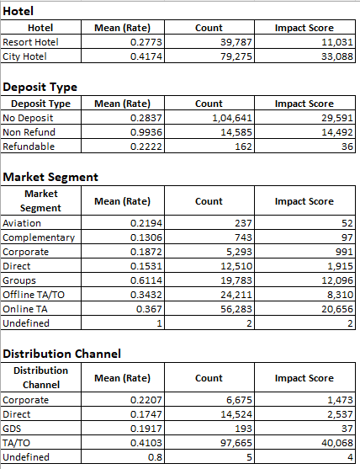
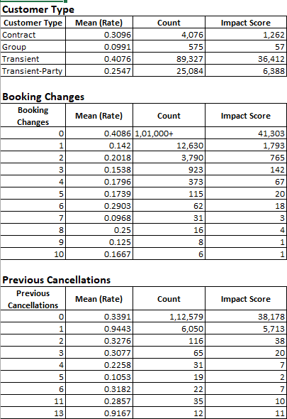
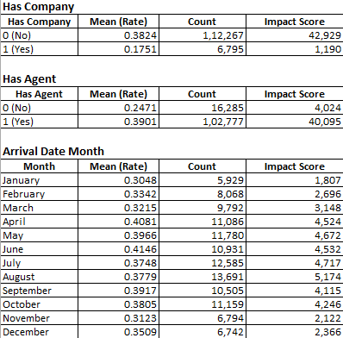
Impact Score Tables:

Slide 5
Graphs – Revenue Loss

Slide 6
Graphs – Revenue Loss

Slide 7
Drivers for cancellation
Driver | Cancellation Rate | Bookings Affected | Revenue Lost | Loss %
Non-Refund deposit | 99.4% | 14,585 | ₹3,598,607 | 99.53%
Repeat cancellers (previous cancellations ≥ 1) | 94.4% | 6,050 | $1,341,743 | 95.2%
Groups (market segment) | 61.1% | 19,783 | $2,799,864 | 60.18%
City Hotel (Hotel type) | 41.7% | 79,275 | $10,866,064 | 43.09%
Online TA (market segment) | 36.7% | 56,283 | $10,100,106 | 42.67%
TA/TO (distribution channel) | 41.0% | 97,665 | $15,153,632 | 42.33%
Transient (customer type) | 40.8% | 89,327 | $14,704,241 | 43.53%
Has Agent = Yes | 39.0% | 102,777 | $15,435,507 | 40.08%
0 Booking Changes | 40.9% | 101,000 | $15,149,843 | 43.23%
Peak season (Apr–Jun) | — | 33,797 | $5,226,553 | 42.43%
Has Company = No (contrast — higher risk) | 38.2% | 112,267 | $16,359,229 | 39.74%

Slide 8
Findings
Deposit Type — Non-Refundable: 99.4% cancellation rate (14,585 bookings) — near-total cancellation despite being labeled "non-refundable." Your strongest, most counterintuitive finding.
Previous Cancellations ≥1: 94.4% rate (6,050 bookings) — guests who've cancelled before almost always cancel again. Small volume but extremely high predictive confidence.
Market Segment — Groups: 61.1% rate (19,783 bookings) — highest genuine rate among all market segments (not Online TA, which sits at baseline).
Hotel Type — City Hotel: 41.7% rate vs Resort's 27.7% (79,275 vs 39,787 bookings) — City Hotel has both a higher rate and higher volume, making it your largest overall problem area.
Distribution Channel — TA/TO: 41.0% rate (97,665 bookings) — largest channel by volume and above-baseline rate.
Customer Type — Transient: 40.8% rate (89,327 bookings) — largest customer-type segment, cancels above baseline.
Has Agent = True: 39.0% rate (102,777 bookings) — agent-booked stays cancel more than direct (24.7%); likely overlapping population with the TA/TO finding above.
Booking Changes = 0: 40.8% rate (~101,000 bookings) — guests who never amend their booking cancel far more than those who make 1+ changes (14–20%). Engagement with the booking correlates with commitment.
Seasonality — Peak season (Apr–Aug): Rates of 37.5–41.5% vs 30.5–35.1% in Nov–Feb — cancellations are higher exactly when hotels stand to lose the most revenue (peak pricing season).
Booked by Company - If Booked by a company cancellation process rate is low (17%) else it is high (38.2%) but this is not a driver of cancellation

Slide 9
Steps to Take
Prioritize City Hotel in your implementation sequencing
charge the card at time of booking, not at check-in, so "non-refundable" has real teeth. (Fixes Non-Refundable cancels)
Auto-flag at booking: if previous_cancellations > 0, require prepayment or a mandatory confirmation call before the reservation is finalized. (Most cancels by people already cancelled)
For Groups:
Tiered deposit by group size: e.g., 20% deposit for 5+ rooms, scaling up for larger blocks.
Mandatory reconfirmation 14–21 days before arrival — group organizers often lose track of headcount changes.
Frame it as a value-add, not a warning — "confirm your stay to unlock late checkout" — encourages engagement without alarming genuine guests.
The real fix is treating "City Hotel + TA/TO + Transient" as one combined risk profile.
Negotiate stricter cancellation terms with high-volume OTA partners
Reduce "free cancellation" default visibility for OTA listings where StayWell controls the rate plan.
Loyalty/incentive nudges at booking (small perk for confirming, e.g., free breakfast) to increase commitment — cheaper than losing the room entirely. Also can increase chance to book again.
If we can move X% of Transient bookings toward corporate-style commitment (deposits, contracts), we'd expect cancellation rates to fall toward 18-20%. This is worth a sales push.

Slide 10
Solutions
Build a real-time cancellation-risk score at booking, combining deposit_type + market_segment + previous_cancellations + booking_changes — even a simple rules-based flag lets front-desk/revenue teams prioritize which bookings need a confirmation call, rather than treating every booking equally.
Dynamic overbooking buffer, calibrated per hotel and segment (higher buffer for City Hotel + TA/TO + Groups, lower for Corporate/Resort) to recover some of the revenue currently lost to empty-room cancellations.

Slide 11
Tools & Links
Tools
Python
Google Colab
Excel
Links
Github repo: https://github.com/Sivasubramaniyan161004/Quantrix_Round2
Google Colab: https://colab.research.google.com/drive/156Jc2AgWd5OAyhkmuiNgQ9oVhrxW1qfn?usp=sharing

